Slide 1

WORKPLACE SAFETY ANALYSIS
Jia Yee Wong

Slide 2

INTRODUCTION
In 2023, fined $7,000 due to death of a worker in warehouse (Staff and Bebout 2023 ).
$60,000 penalty for exposing employee to hazard (Palmer 2023).
Had over 50 investigations by OSHA since 2020 (Scheiber 2024 ).
Total fines = more than $6 million since 2020

Slide 3

GOAL
Investigate workplace injury in office and non-office environments in the U.S
Focus on financial impact and regional trends

Slide 4
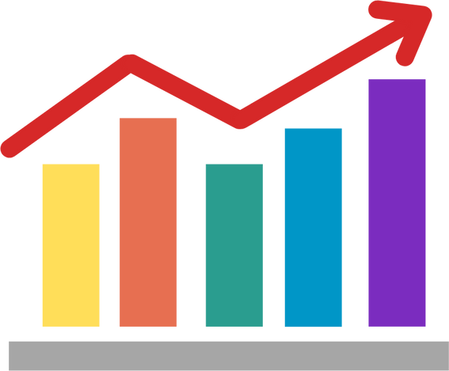
DATA
Data Sources
Data Features
Census of Fatal Occupational Injuries (CFOI)
Survey of Occupational Injuries and Illnesses (SOII)
CDC State-by-State Occupational Health Data
Liberty Mutual Insurance
Injury types
Industries categories
Severity
Worker Demographic
Work environment
Geography

Slide 5

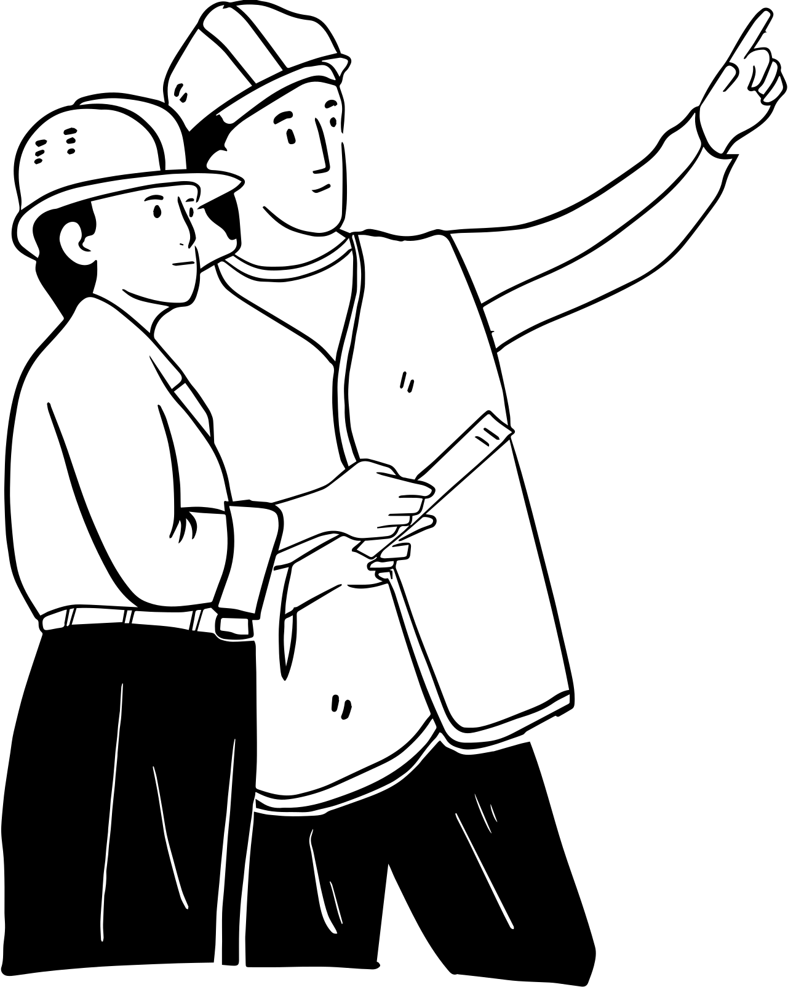
DATA CLASSIFICATION
Office-related injuries
Non office injuries
Others
Falls on the same level
Slips or trips without fall
repetitive motions
Falls to lower level
Struck by object
Roadway incidents
Being caught in equipment
Struck against object
Overexertion involving outside sources
Other exertions or bodily reactions

Slide 6
PACKAGES AND SOFTWARE
R (version 4.3.2)
readxl (Wickham and Bryan 2023)
tidyverse (Wickham et al. 2019)
ggplot2 (Wickham 2016)
scales (Wickham, Pedersen, and Seidel 2023)
knitr(Xie 2024)

Slide 7
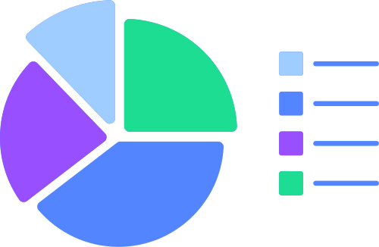
ANALYTICAL APPROACH
Proportions of injury costs were calculated by environment type
t-test
ANOVA
Pearson correlation

Slide 8
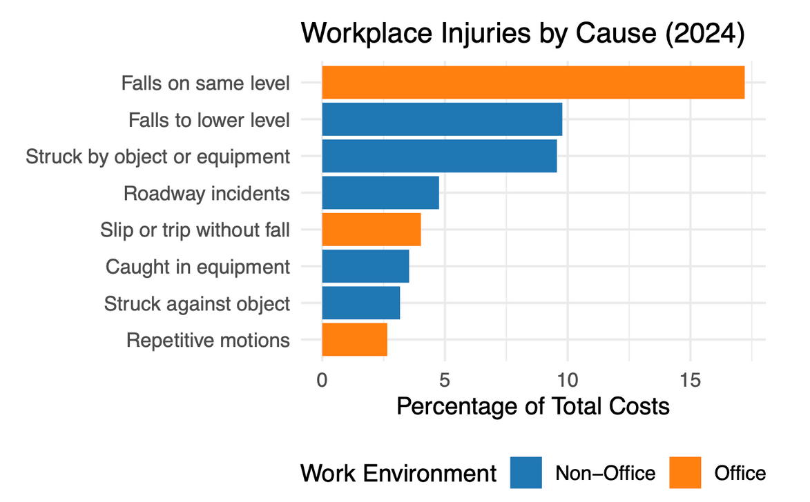
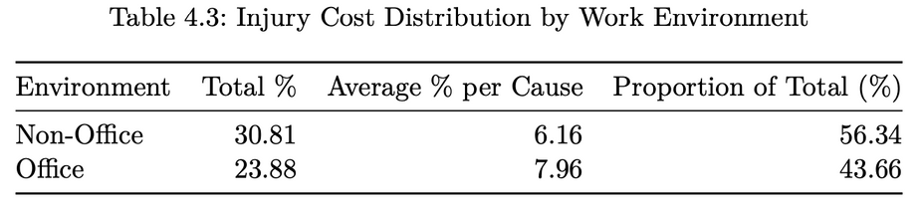
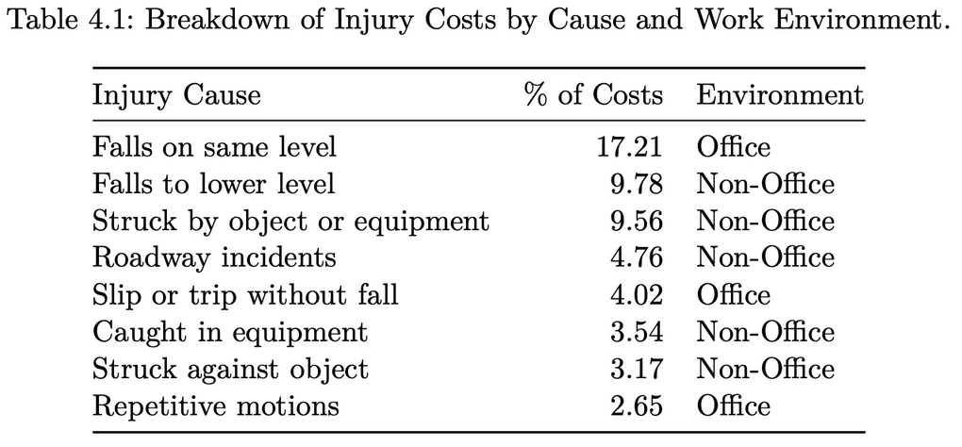
RESULTS

Slide 9
T-TEST RESULTS
No significant difference identified
t(2.40) = 0.37, p=0.74
Office: 7.96% (SD = 8.04)
Non-Office: 6.16% (SD = 3.26)
95% CI: [-16.11, 19.71]

Slide 10
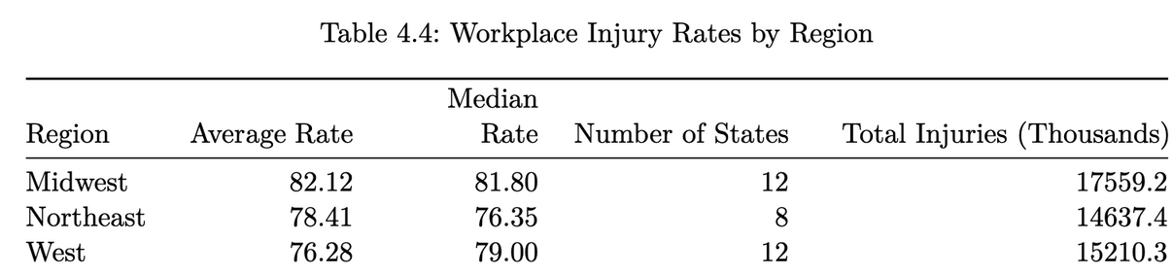
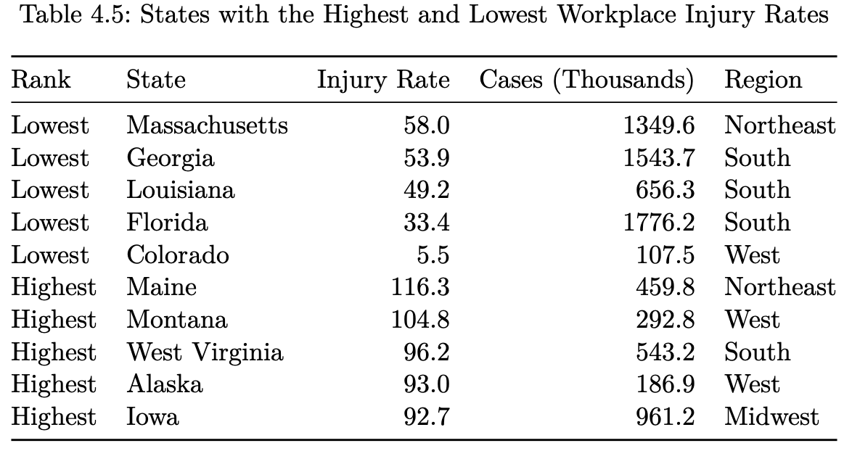
RESULTS

Slide 11
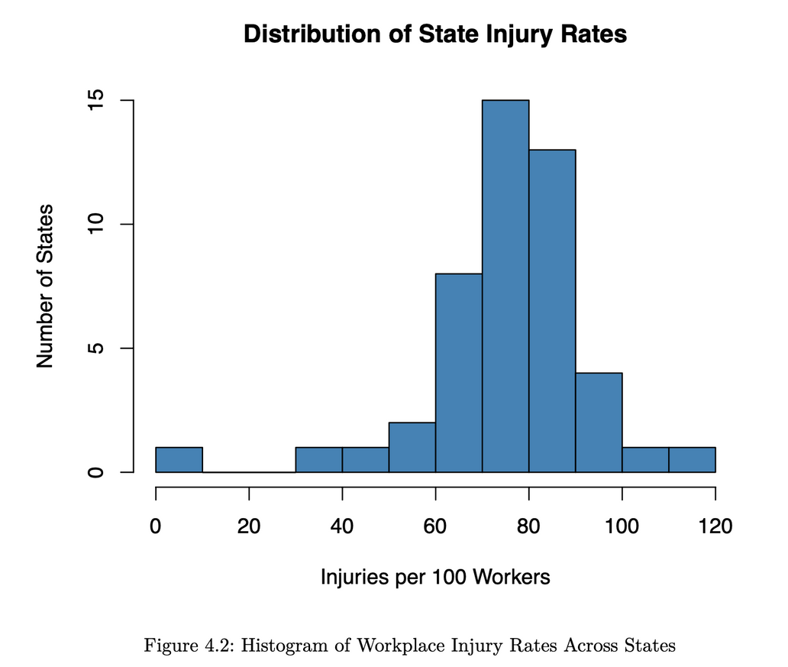
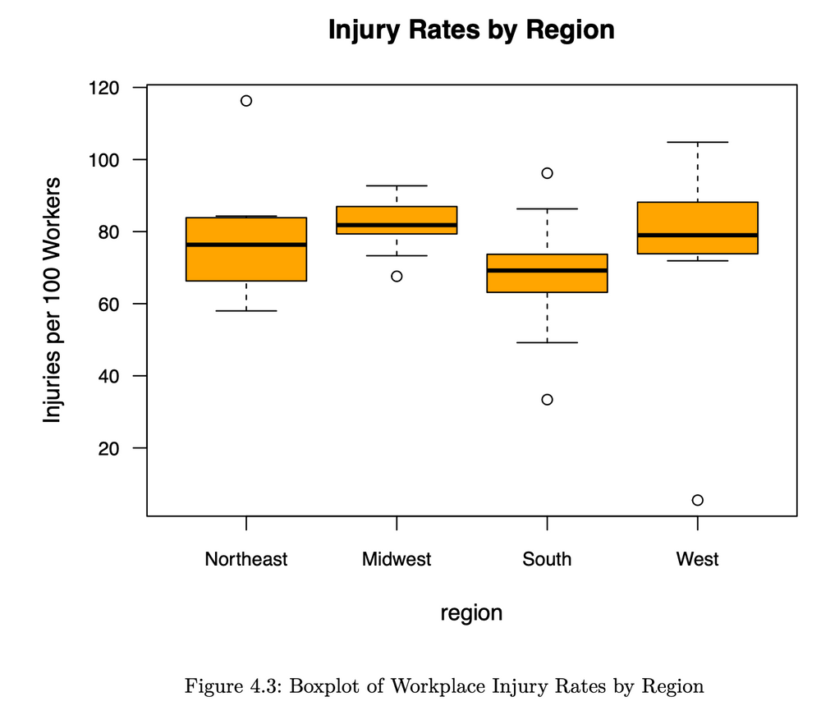
RESULTS

Slide 12
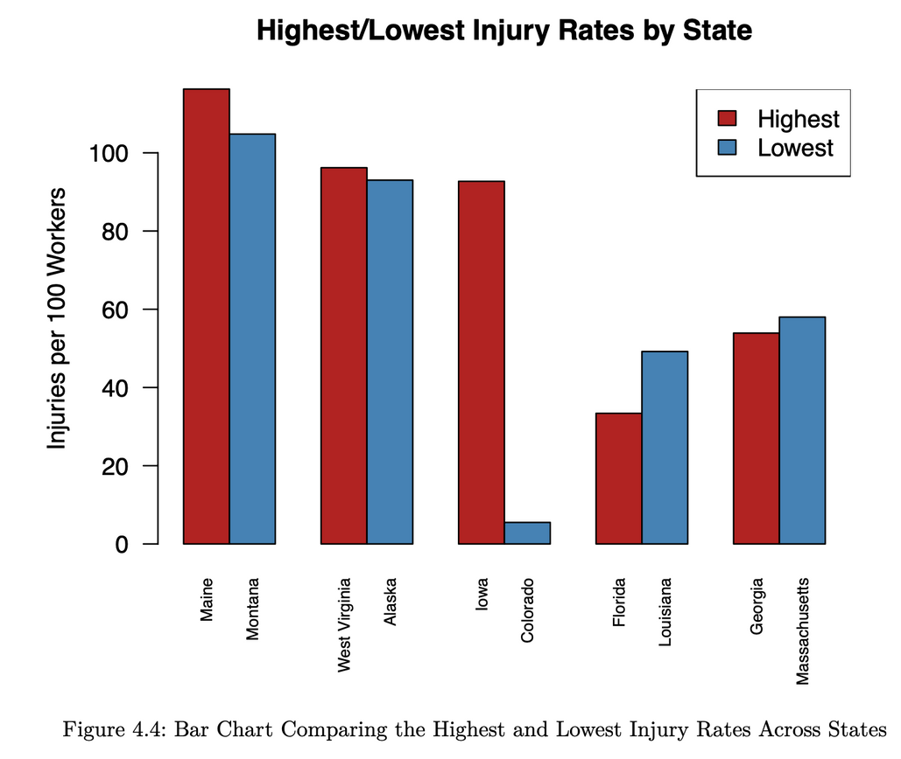
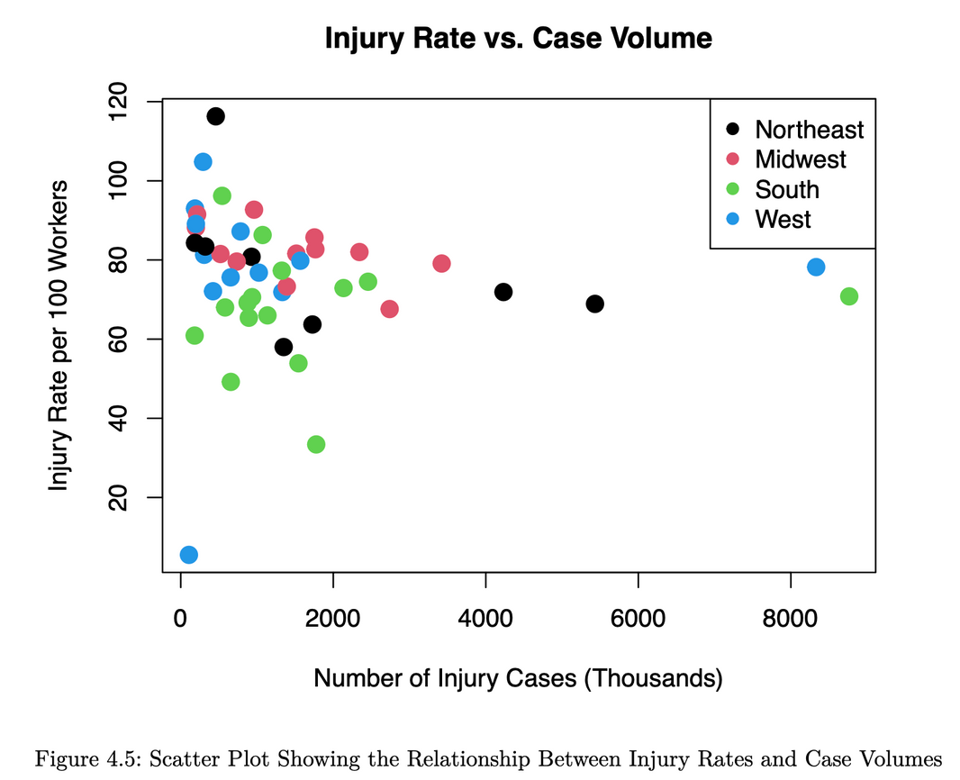
RESULTS

Slide 13
RESULTS
One-way ANOVA showed no significant differences, p=0.168
No significant correlation found, r=-0.99 and p=0.553

Slide 14
CONCLUSIONS
Office environments account for 23.9% of total injury costs; non-office environments contribute 30.8%.
Falls are the leading cause of injury in both settings, with office falls being disproportionately costly.
Regional injury rates varied, but no statistically significant differences were found.
No meaningful relationship was identified between injury volume and injury rates.

Slide 15
LIMITATIONS
Public data may not fully capture unreported incidents or industry-specific variations.
Data collection inconsistencies could affect accuracy.

Slide 16

RECOMMENDATIONS
Enhance Fall Prevention in Oﬀice Setting
Conduct Region-Specific Safety Assessment

Slide 17


THANK YOU!

Slide 18
REFERENCES
Palmer, Annie. 2023. “Amazon Cited by Labor Department for Exposing Warehouse Workers to Safety Hazards.” CNBC. https://www.cnbc.com/2023/01/18/amazon-cited-by-osha-for- exposing-warehouse-workers-to-safety-hazards.html.
Scheiber, Noah. 2024. “Amazon Is Fined Nearly $6 Million Over Warehouse Work Quotas - The New York Times.” June 18, 2024. https://www.nytimes.com/2024/06/18/business/economy/amazon-california-productivity-quota.html.
Staff, WPTA, and Jazlynn Bebout. 2023. “Fort Wayne Amazon Facility Fined for Safety Violation Leading to 20-Year-Old Worker’s
Death.” https://www.21alivenews.com. November 28, 2023. https://www.21alivenews.com/2023/11/28/fort-wayne-amazon-facility-fined- safety-violation-leading-20-year-old-workers-death/.
Wickham, Hadley. 2016. Ggplot2: Elegant Graphics for Data Analysis. Springer-Verlag New York. https://ggplot2.tidyverse.org.
Wickham, Hadley, Mara Averick, Jennifer Bryan, Winston Chang, Lucy D’Agostino McGowan, Romain François, Garrett Grolemund, et al. 2019. “Welcome to the tidyverse.” Journal of Open Source Software 4 (43): 1686. https://doi.org/10.21105/joss.01686.
Wickham, Hadley, and Jennifer Bryan. 2023. Readxl: Read Excel Files. https://CRAN.R- project.org/package=readxl.
Wickham, Hadley, Thomas Lin Pedersen, and Dana Seidel. 2023. Scales: Scale Functions for Visualization. https://CRAN.R-project.org/package=scales.
Xie, Yihui. 2024. Knitr: A General-Purpose Package for Dynamic Report Generation in r. https://yihui.org/knitr/.

